Slide 1
Define CRDT In CRONUS
Acher Quentin

Slide 2
Sections of definitiion
In the folder “example”, multiple folders defining CRDTs Can be found.
To create a new CRDT Create a folder with the name of the CRDT (eg. MyCrdt)
and a go file inside with the same name “MyCrdt.go”
the go package of the file should be the same name “MyCrdt”
This Package need to include multiple definition, that we present in this pdf :
The Folder “EmptyExemple” Is showing how to implement a Operation-based CRDT (String set) With no measurement
operation → Define what is an operation, and on what element they act
Payload definition → define what is in the payload
CRDT → Define the CRDT itself so we can compute the CRDT from the DAG
CRDTDagNode → Define the CRDTDag Node, what should be carried in every nodes,
( Default is at least Payload, Dependency and Peer ID)
CRDTDag → Define the merge of noes, add of nodes, and link with Ipfs

Slide 3
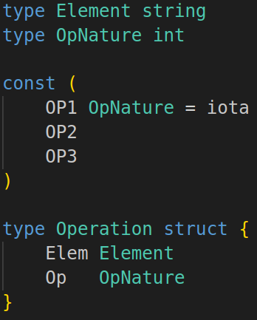
Definition of operations
Define the Data in itself

Slide 4
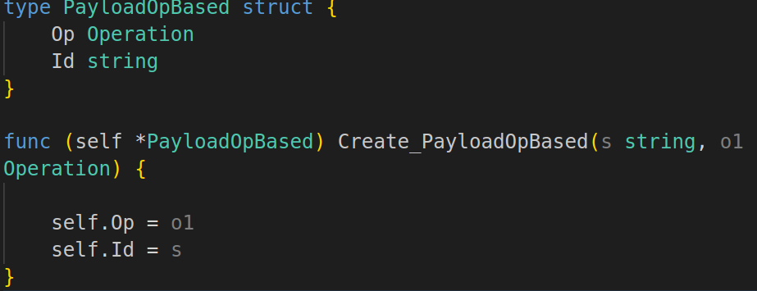
Definition of Paylaods
Define what is a payload
(it only carry an operation as it is op based here, it can carry more in state/delta Based)

Slide 5
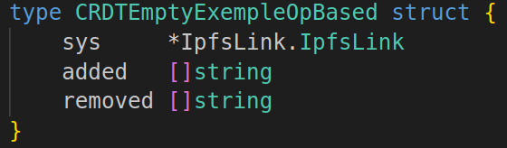
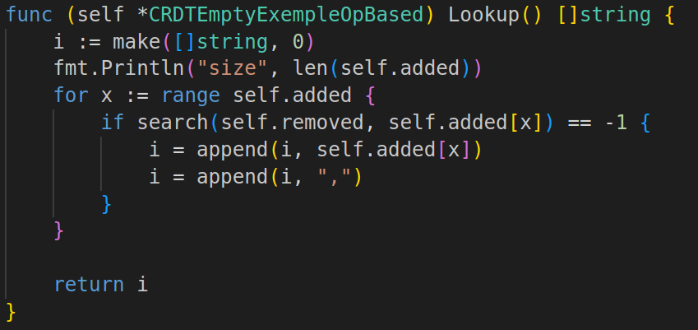
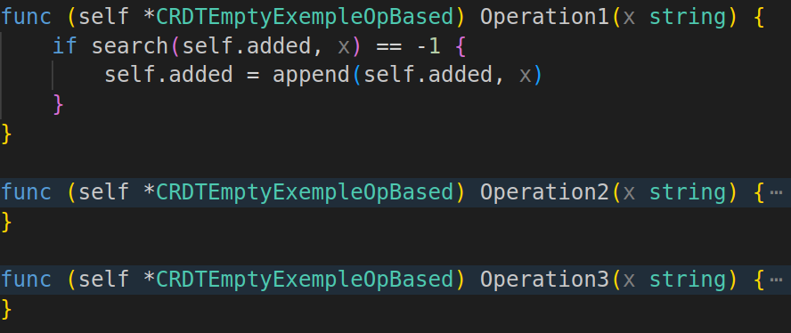
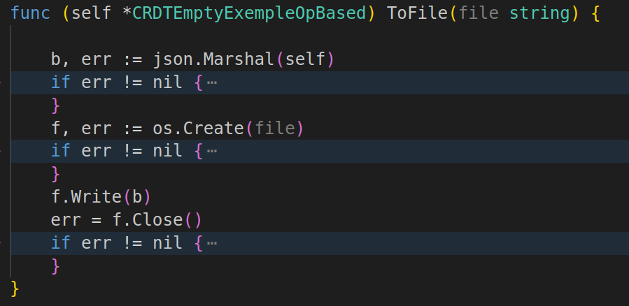
Definition of the CRDT
Define the data of the CRDT
Lookup, to get the data’s value
Define the operations on it
To respect the CRDT Interface, implement a “MyCRDT.ToFile(string)” function

Slide 6
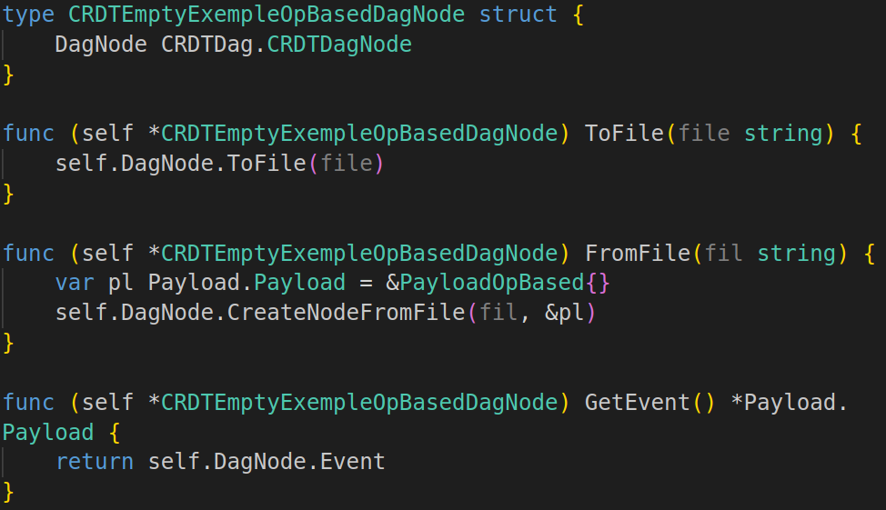
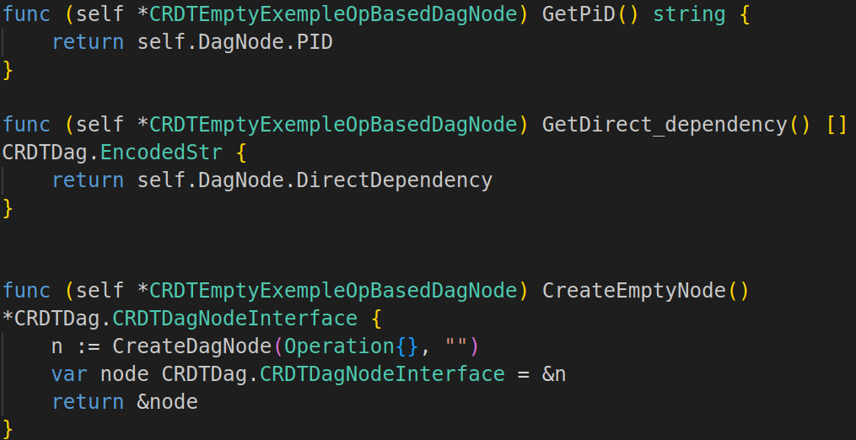
Definition of CRDTDagNode
This has to implement the CRDTDagNode Interface : “CRDTDag/CRDTDagNode”
Straight forward definition here

Slide 7
Definition of CRDTDag
CRDTDagNode

